Slide 1
SIMULATION RESULTS

Slide 2
Why are we modeling traffic?
Simulation of common traffic conditions
  Recurrent congestion
  Incidents
Simulation of potential Response Plans
  Do nothing
  Rerouting
  Adjusted Signal Plans
Evaluation of Response Plans
  VHT

Slide 3
Outline
What network we are modeling
What we did last time
What we plan to show this time
  Incident modeling
  Response plan

Slide 4
Outline
What network we are modeling
What we did last time
What we plan to show this time
  Incident modeling
  Response plan

Slide 5




Network
Fair Oaks Ave
Marengo Ave
Lake Ave
Allen Ave
Altadena Ave
Colorado Blvd
Los Robles
Hill Ave
Sierra Madre Villa Ave
San Gabriel Blvd
Michililinda Ave
Colorado St
Colorado Pl
Maple St
Orange Grove Blvd
Myrtle Ave
Mountain Ave
Corson St
Foothill Blvd
Buena Vista St
Walnut St
Huntington Dr
Duarte Rd
Santa Anita Ave
Azusa Ave
Simulated freeway ~18.5 mi
Simulated arterial ~ 3.3 mi

Slide 6
Outline
What network we are modeling
What we did last time
What we plan to show this time
  Incident modeling
  Response plan

Slide 7
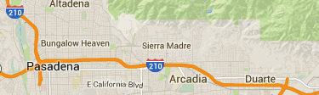
Last time we showed
Reproduce typical day
  No-incident
  PM peak period
  Off-peak direction

Slide 8
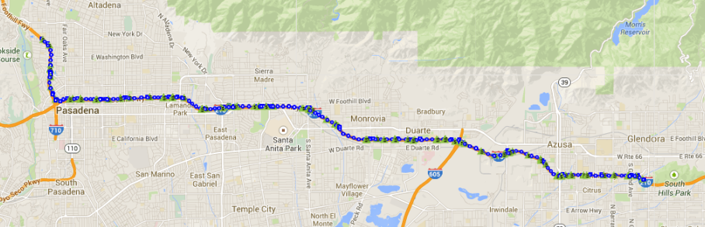
The site
19 miles of 210 Westbound from PM 42 to 23.
23 on-ramps, 21 off-ramps.
Heavy morning congestion, light afternoon congestion.
PM 23
Huntington St. detour
I-605
PM 30
PM 42

Slide 9
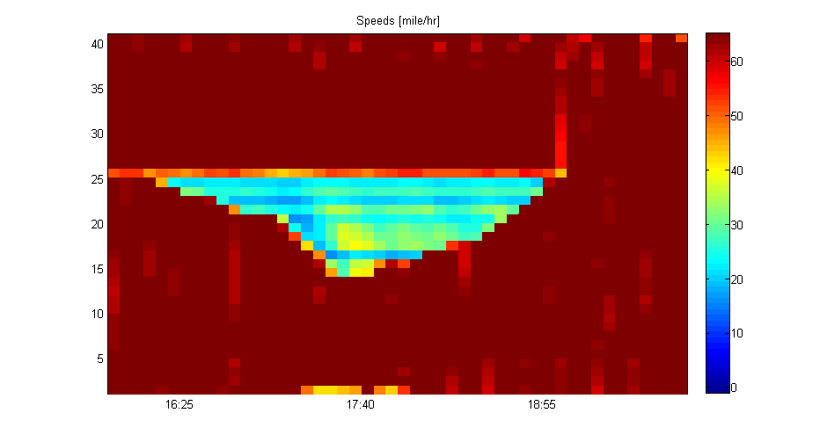
Freeway simulation results
Inspection of congestion
16:20
18:50
Baldwin
I-605

Slide 10
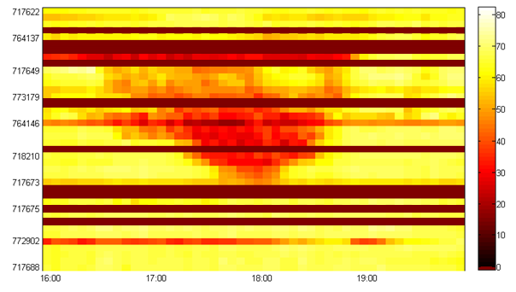
Freeway Observed congestion (PeMS)
Inspection of congestion
16:20
18:50
Baldwin
I-605
bad detection
22-May-2014

Slide 11


Freeway calibration results
~80% of hourly mainline flows are within acceptable limits.
Total flows are within acceptable limits errors balance out.
Criterion | 4:00 pm 5:00 pm | 5:00 pm 6:00 pm | 6:00 pm 7:00 pm | 7:00 pm 8:00 pm
flow within 400 vph of measurement | 78% | 78% | 83% | 82%
Individual link GEH < 5 | 78% | 78% | 83% | 67%
Total flow within 5% of measurements
Total GEH < 4

Slide 12
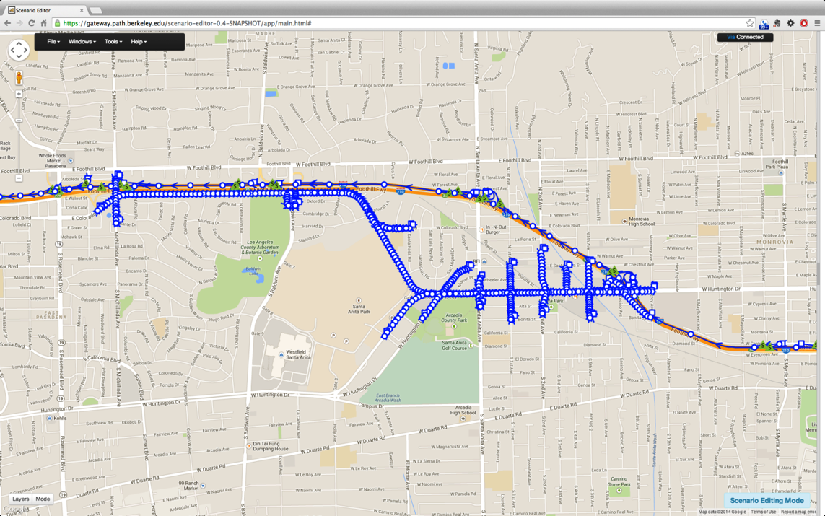
I-210 Arterial and Freeway Model
Number of links: 1001
Freeway: 210
Arterial: 791
Number of signalized intersections: 13

Slide 13
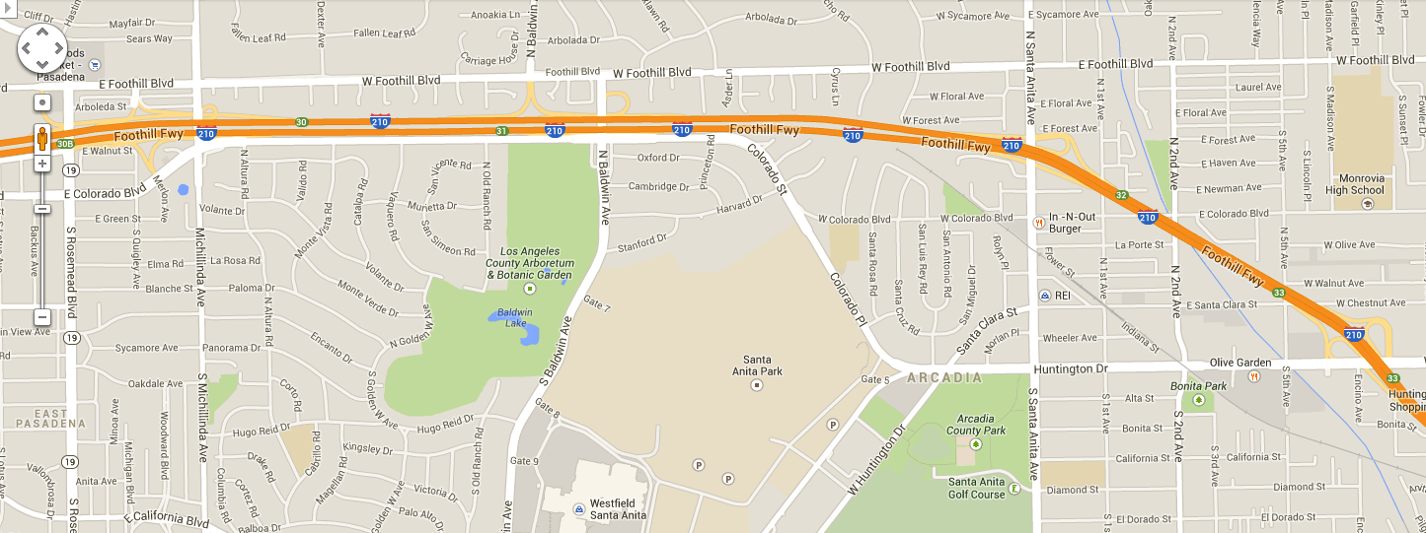
Data - Arterial
On arterial, we only have 5-min loop data at limited locations

Slide 14
Simulated Westbound traffic on Huntington and Colorado

Slide 15
Estimated vs. Measured Flows, 16:00-17:00
Individual link flows | Passed cases | Targets
Flow within 100 vph for link flows < 700 vph | 4/5 = 80% | > 85%
Flow within 15% for 700 vph < link flows < 2700 vph | 6/9 = 67% | > 85%
Flow within 400 vph for link flows > 2700 vph | 0/0 | > 85%
GEH statistics < 5 | 10/14 = 71% | > 85%
Sum of all link flows | Results | Targets
Relative Error in Total Flow | 5.4% | < 5%
GEH | 5.5 | < 4

Slide 16
Outline
What network we are modeling
What we did last time
What we plan to show this time
  Incident modeling
  Response plan

Slide 17
Definitions
Passive reroute: Drivers exit the freeway and seek an alternate route on the surrounding arterials on their own
Active reroute: System operators use traveler information and wayfinding mechanisms (CMS, trailblazer signs, radio, mobile apps) to actively influence drivers’ route choice

Slide 18
Today we will show: incident modeling
Reproduce incident day
Additional flow on arterial;
caused by passive reroute of drivers

Slide 19
Today we will show: response plan
Increase cycle length of arterial lights
➔ larger arterial capacity
➔ larger network-wide capacity
➔ less congestion

Slide 20
Summary of Incident Runs
Run | Story |  |  | VHT
 | Incident | Reroute | Signal Plan
1 | No | No | Normal | 9,557 veh*h
2 | Yes | Passive | Normal | 10,245 veh*h
3 | Yes | Passive | Adjusted | 10,173 veh*h (cp. 2: ∆ -72 veh*h)
4 | Yes | Active | Adjusted | 9,919 veh*h (cp. 2: ∆ -326 veh*h)

Slide 21
Network
Fair Oaks Ave
Marengo Ave
Lake Ave
Allen Ave
Altadena Ave
Colorado Blvd
Los Robles
Hill Ave
Sierra Madre Villa Ave
San Gabriel Blvd
Michililinda Ave
Colorado St
Colorado Pl
Maple St
Orange Grove Blvd
Myrtle Ave
Mountain Ave
Corson St
Foothill Blvd
Buena Vista St
Walnut St
Huntington Dr
Duarte Rd
Santa Anita Ave
Azusa Ave
Simulated freeway ~18.5 mi
Simulated arterial ~ 3.3 mi

Slide 22
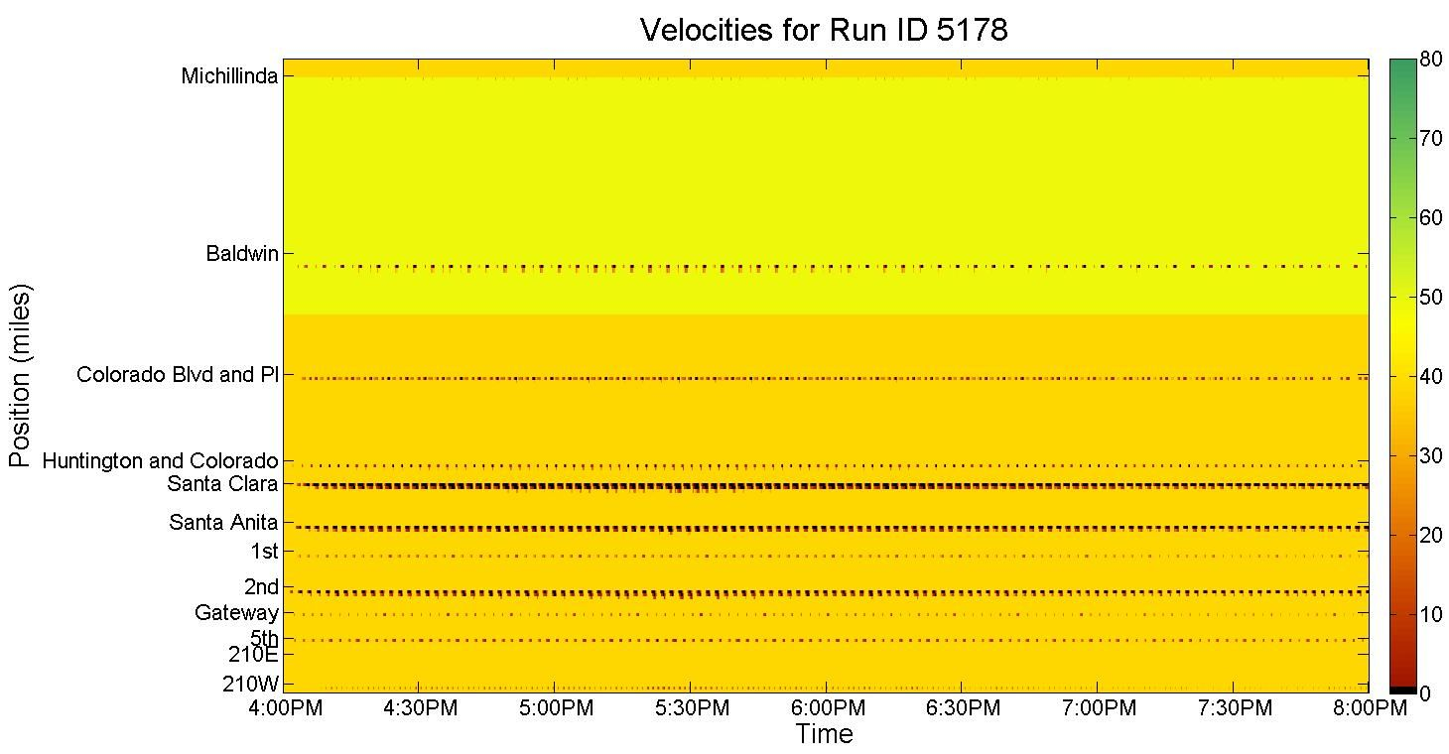
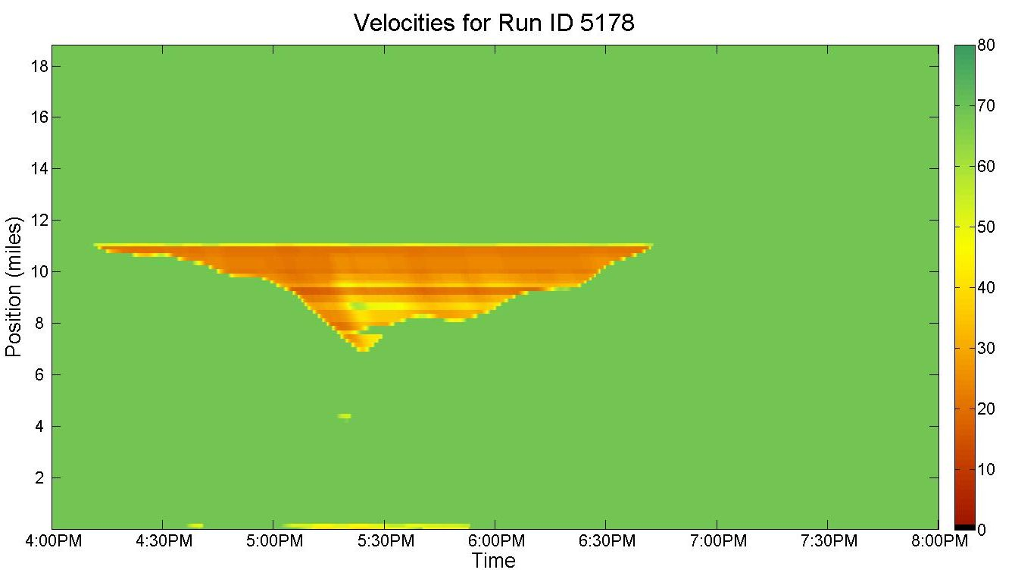
Run 1: No incident
“the Baseline”
Arterial,
Huntington & Colorado westbound
Freeway,
I210
westbound
No incident
No reroute
120s cycle time
Baseline
Recurrent
bottleneck
May 22nd, 2014

Slide 23

Run 1: No incident
“the Baseline”
Arterial,
Huntington & Colorado westbound
Freeway,
I210
westbound
No incident
No reroute
120s cycle time
Baseline
Recurrent
bottleneck
May 22nd, 2014

Slide 24
Run 1: No incident
“the Baseline”
Arterial,
Huntington & Colorado westbound
Freeway,
I210
westbound
No incident
No reroute
120s cycle time
Baseline
Recurrent
bottleneck
May 22nd, 2014

Slide 25
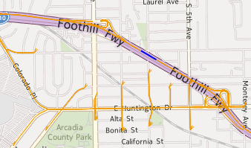

Incident & Reroute
Incident on freeway from 16:30 to 17:00;
remaining capacity is 5000 veh/h
Reroute @exit Huntington
from 16:35 to 17:05

Slide 26
Evidence for Passive Rerouting
Multiple incidents on I210W downstream of Huntington exit
from 17:30 and 19:00
+460 veh/hr
during incident

Slide 27
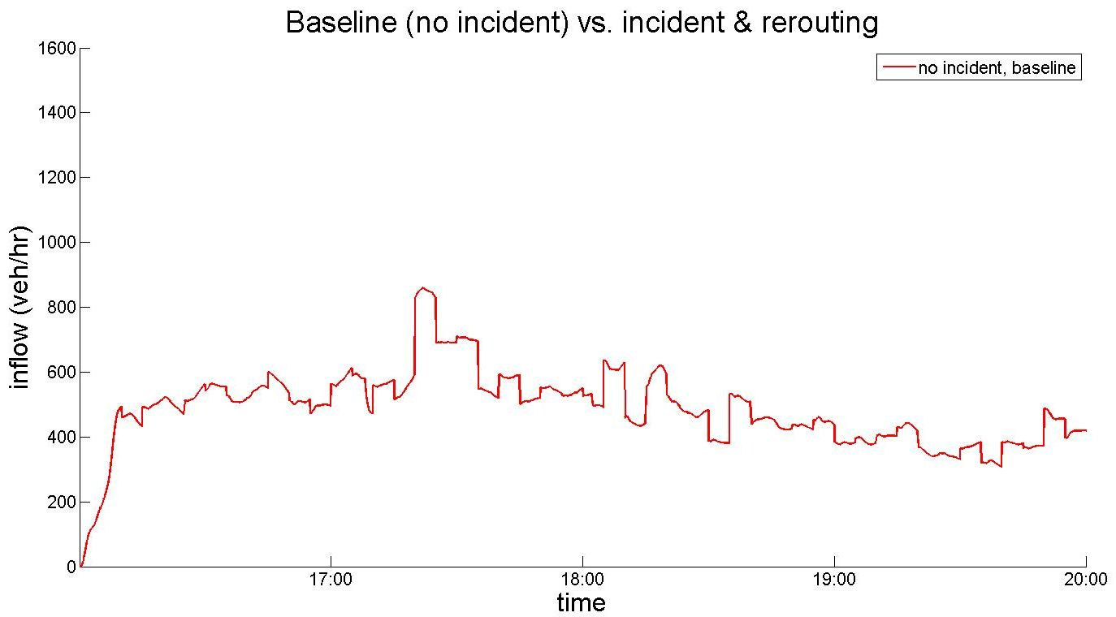
Flow @exit Huntington
Off-ramp flow when no incident

Slide 28
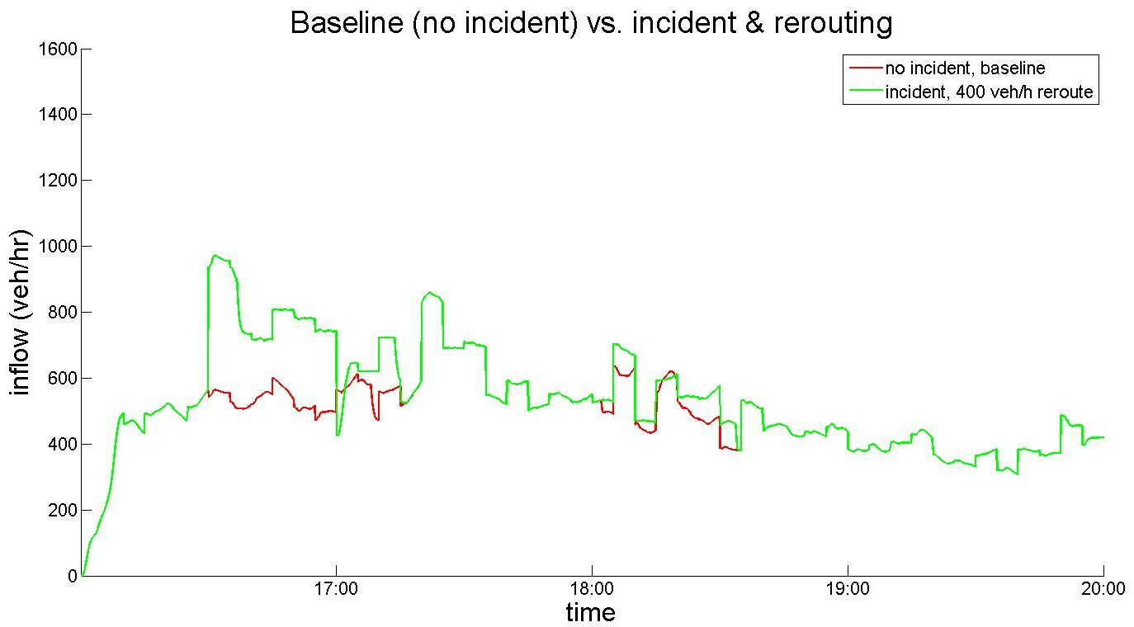
Flow @exit Huntington
Increased off-ramp flow during incident
due to passive reroute
Rerouted flow
Reroute active
16:35-17:05
Off-ramp flow when no incident

Slide 29
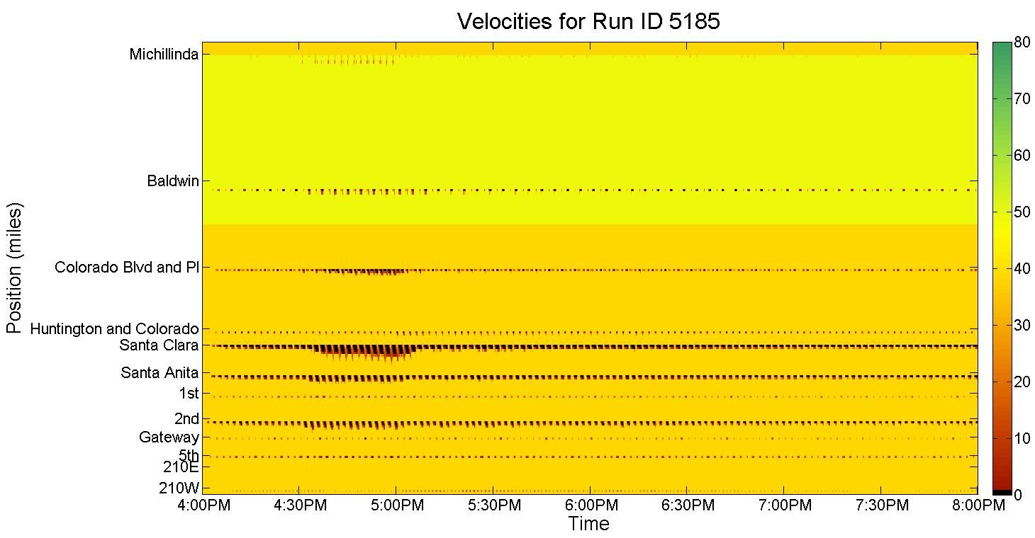
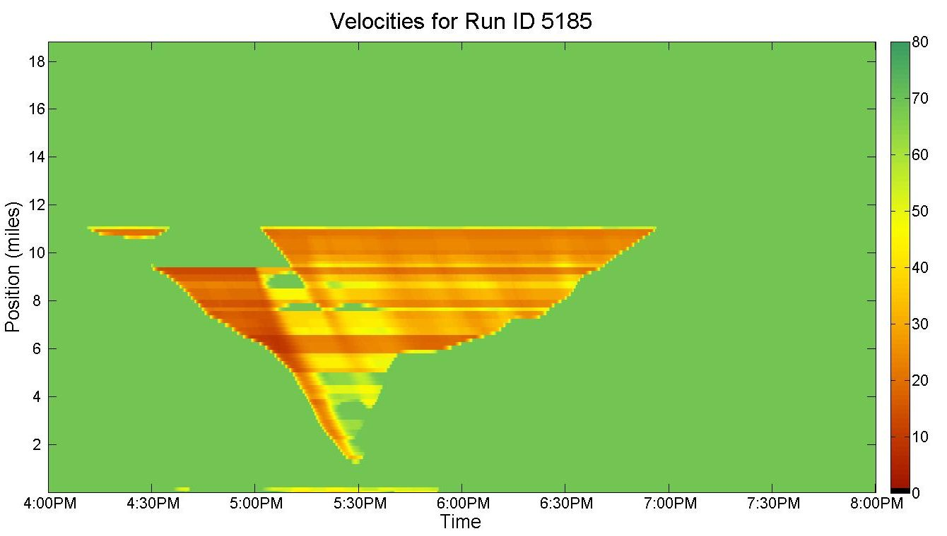
Run 2: Incident, 400 veh/h reroute
“Passive Reroute, no response plan”
Incident
400veh/h reroute
120s cycle time
Based on data
arterial
freeway
Recurrent
bottleneck
Incident duration
Queue extent
Queue ~8mi

Slide 30

Run 2: Incident, 400 veh/h reroute
“Passive Reroute, no response plan”
Incident
400veh/h reroute
120s cycle time
Based on data
arterial
freeway
Recurrent
bottleneck
Incident duration
Queue extent
Queue ~8mi

Slide 31
Run 2: Incident, 400 veh/h reroute
“Passive Reroute, no response plan”
Incident
400veh/h reroute
120s cycle time
Based on data
arterial
freeway
Recurrent
bottleneck
Incident duration
Queue extent
Queue ~8mi

Slide 32
Comparison of Contour Plots
Run 1: No Incident vs. Run 2: Incident, 400 veh/h reroute
Significant change in flow on the freeway @offramp Huntington
offramp

Slide 33
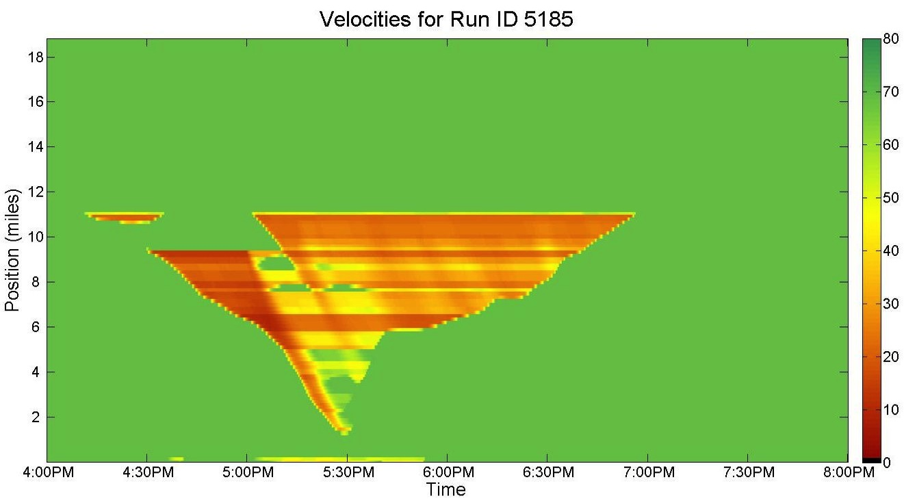
Comparison of Contour Plots
Run 1: No Incident vs. Run 2: Incident, 400 veh/h reroute
Active Reroute
@exit Huntington
Significant change in flow on the freeway @exit Huntington
offramp

Slide 34
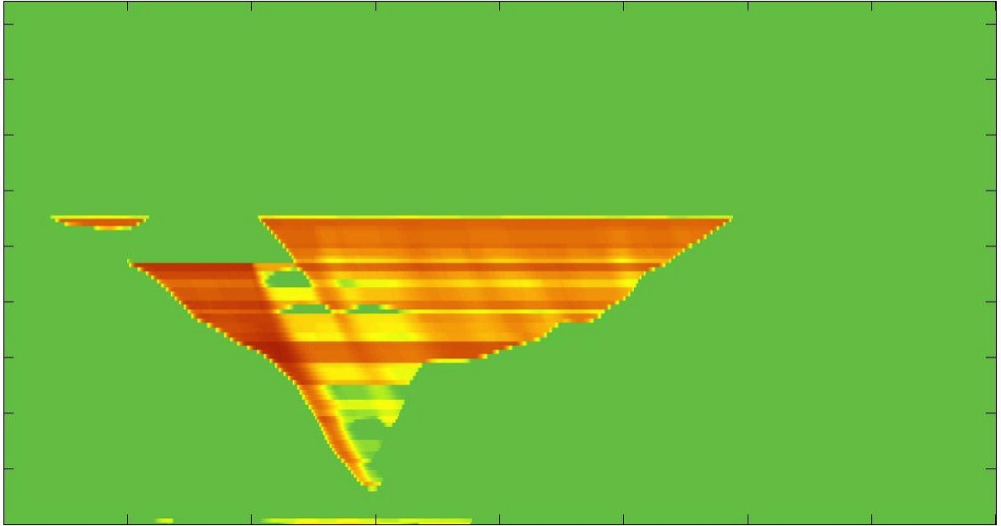
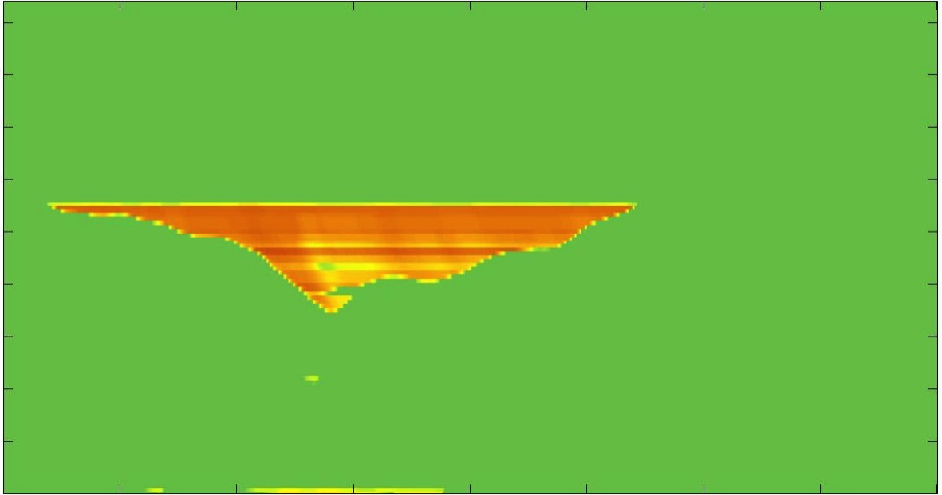
Comparison of Contour Plots
Run 1: No Incident vs. Run 2: Incident, 400 veh/h reroute
same
different
same
different
same
offramp

Slide 35
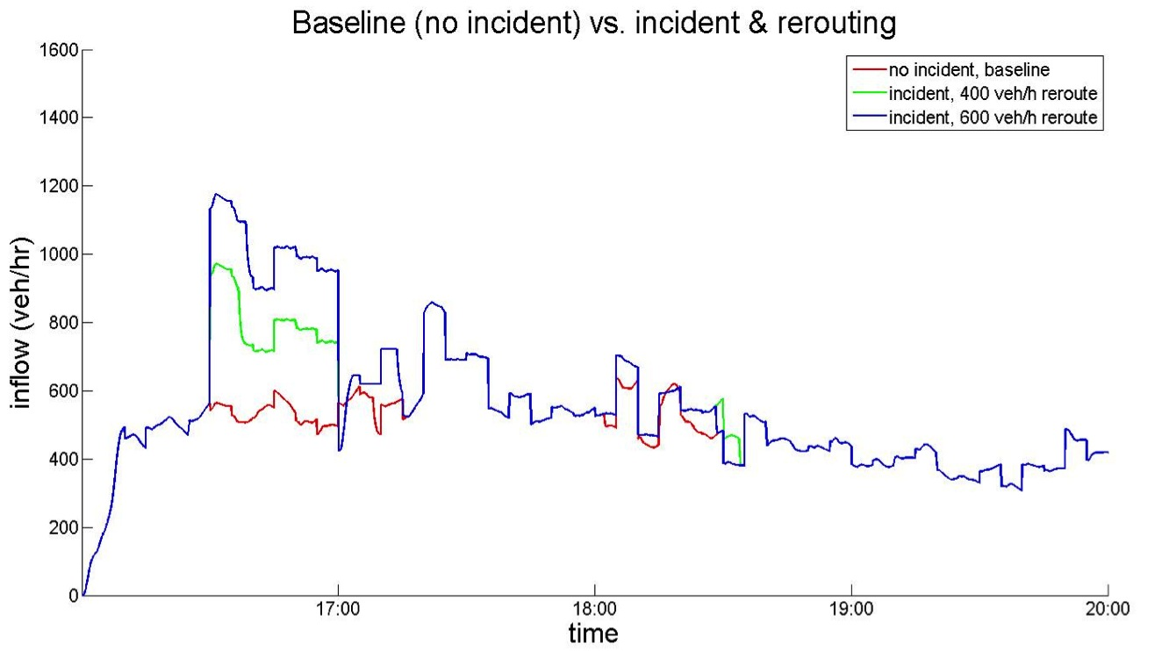
Combination with flow @exit Huntington
same
different
same
different
same
offramp

Slide 36
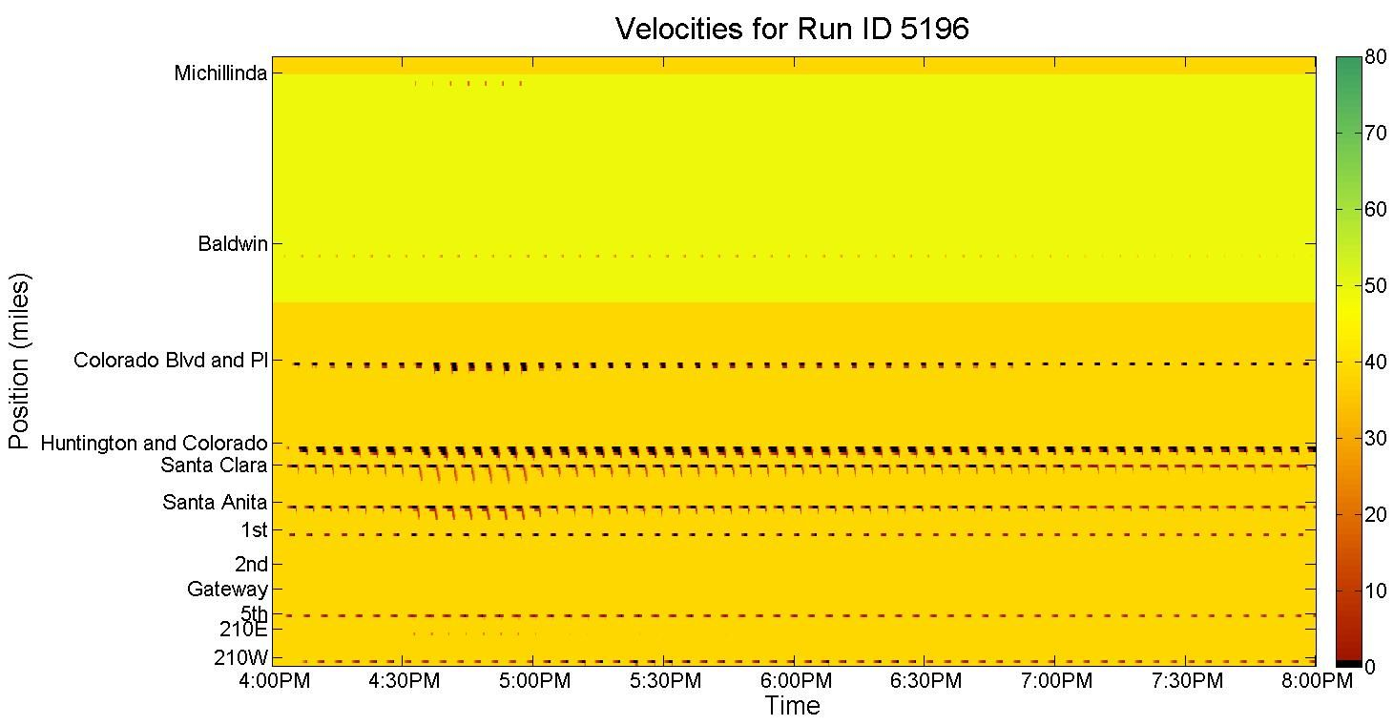
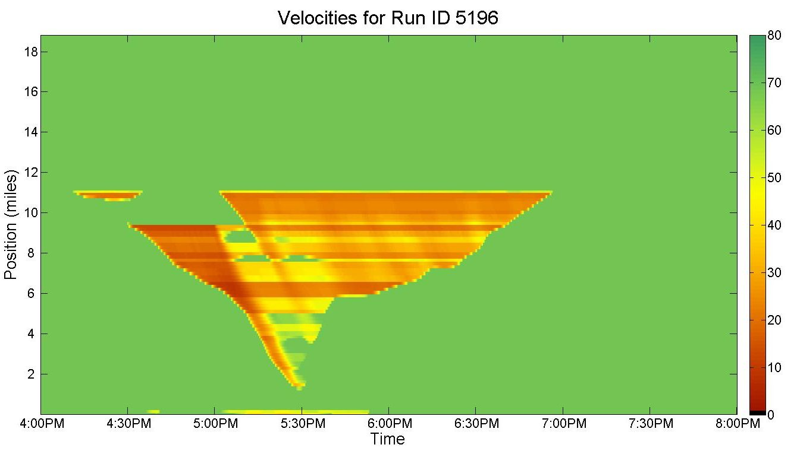
Run 3: Incident, 400 veh/h reroute, cycle time = 240s
“Passive Reroute + Adjusted Signal Plan”
Incident
400veh/h reroute
240s cycle time
Passive reroute
arterial
freeway
Recurrent
bottleneck
Incident duration
Queue extent
Queue ~8mi

Slide 37

Run 3: Incident, 400 veh/h reroute, cycle time = 240s
“Passive Reroute + Adjusted Signal Plan”
Incident
400veh/h reroute
240s cycle time
Passive reroute
arterial
freeway
Recurrent
bottleneck
Incident duration
Queue extent
Queue ~8mi

Slide 38
Run 3: Incident, 400 veh/h reroute, cycle time = 240s
“Passive Reroute + Adjusted Signal Plan”
Incident
400veh/h reroute
240s cycle time
Passive reroute
arterial
freeway
Recurrent
bottleneck
Incident duration
Queue extent
Queue ~8mi

Slide 39
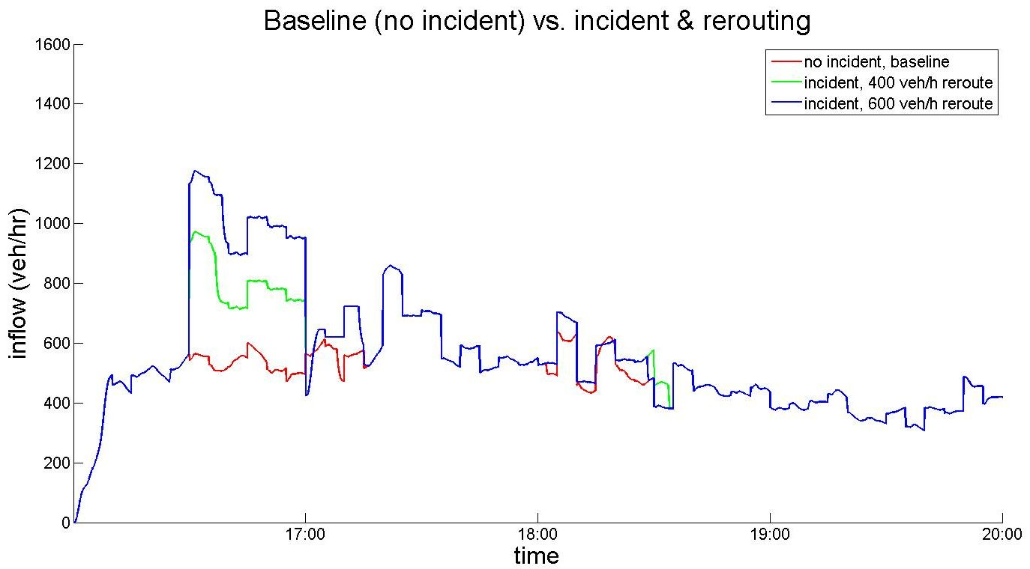
Flow @exit Huntington
Increased off-ramp flow during incident
due to active reroute
Increased off-ramp flow during incident
due to passive reroute
Rerouted flow
Reroute active
16:35-17:05
Off-ramp flow when no incident

Slide 40

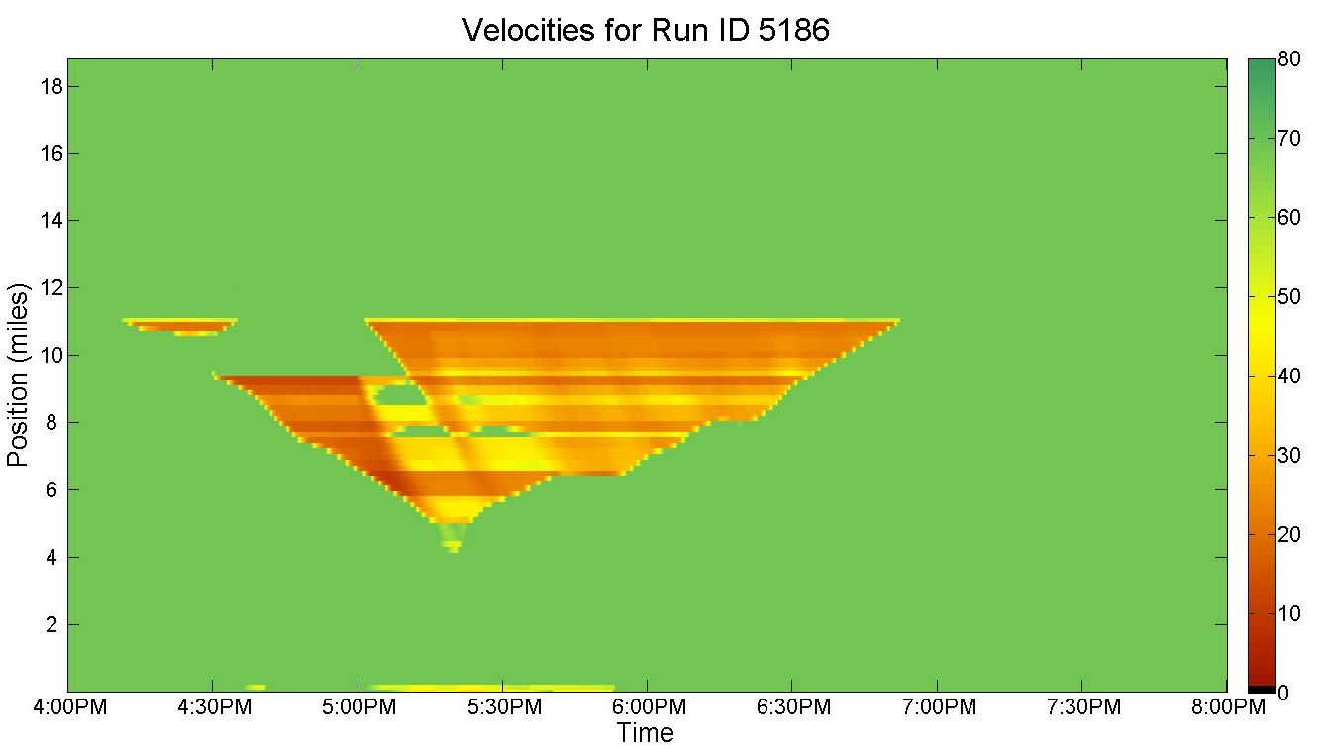
Run 4: Incident, 600 veh/h reroute, cycle time = 240s
“Active Reroute + Adjusted Signal Plan”
Incident
600veh/h reroute
240s cycle time
Active reroute
arterial
freeway
Recurrent
bottleneck
Incident duration
Queue extent
Queue ~4mi

Slide 41

Run 4: Incident, 600 veh/h reroute, cycle time = 240s
“Active Reroute + Adjusted Signal Plan”
Incident
600veh/h reroute
240s cycle time
Active reroute
arterial
freeway
Recurrent
bottleneck
Incident duration
Queue extent
Queue ~4mi

Slide 42
Run 4: Incident, 600 veh/h reroute, cycle time = 240s
“Active Reroute + Adjusted Signal Plan”
Incident
600veh/h reroute
240s cycle time
Active reroute
arterial
freeway
Recurrent
bottleneck
Incident duration
Queue extent
Queue ~4mi

Slide 43
Conclusion
We have a tool to
Simulate different traffic conditions
Simulate Response Plans
Evaluate Response Plans
Run | Incident y/n | Rerouted flow | Cycle time | Story | VHT | Max length of incident queue
1 | No | 0 veh/h | 120s | No incident, Baseline | 9,557 veh*h | -
2 | Yes | 400 veh/h | 120s | Incident, Passive Reroute | 10,245 veh*h | 8 mi
3 | Yes | 400 veh/h | 240s | Incident, Passive Reroute + Adjusted Signal Plan | 10,173 veh*h (cp. 2: ∆ -72 veh*h) | 8 mi
4 | Yes | 600 veh/h | 240s | Incident, Active Reroute + Adjusted Signal Plan | 9,919 veh*h (cp. 2: ∆ -326 veh*h) | 4 mi

