Slide 1
Classification Process
Is working day?
no
Label “Weekend / Holiday”
yes
Is special day?
yes
Label “Other”
no
Rank all incident days by impact
Significant incident?
yes
Label “Incident day”
List of incident days
..
..
..
..
..
no
major
Label “Regular working day”
minor

Slide 2
Criteria for “Is working day?”
Check date of contour plot against calendar
Workings days are
Monday through Friday AND
Are not holidays (national and local)

Slide 3
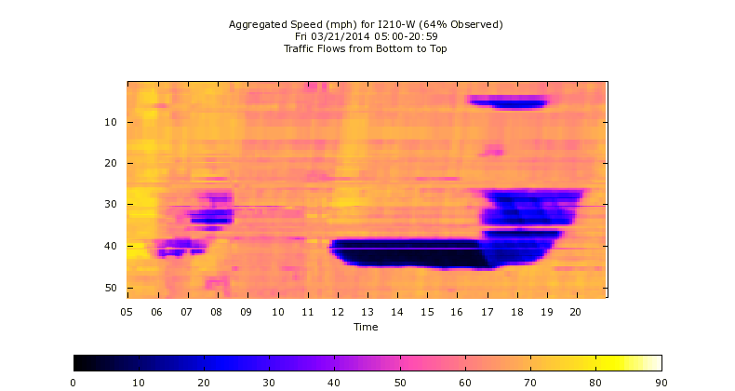
Criteria for “Is Special Day?”
A day is considered special if there contours show one of the following:
A forward moving shock wave present for >=2 hours AND >=2 miles of congestion, during any part of the day
Heavy congestion present (speed <20mi/h OR flow <100 veh/5min) for >=3hrs, during any part of the day

Slide 4
Criteria for “Does contain Significant Incident?”
The beginning of congestion (at a fixed bottleneck) is marked by the following criteria:
Downstream high speed (>50 mi/h)
Upstream low speed (<50 mi/h)
Standing shock wave
Backward moving shock wave
The beginning of an incident is marked by
The beginning of congestion AND
Downstream a sharp sudden drop in flow
Transition happens within 10 min
Flows drops by >200 veh/5min
For comparison: The beginning of regular congestion is marked by
The beginning of congestion AND
Downstream NO sharp sudden drop in flow
An incident is considered significant if
If matches the criteria of the beginning of an incident AND
If the standing shock wave is longer than 30 min AND
The resulting congestion is longer than 3 mi

Slide 5
Ranking of incident days
Rank incident days by their severity of congestion
Procedure:
For each incident day
Calculate space-time coverage of congestion
Sort days according to congestion coverage
1.)
2.)
3.)

Slide 6
Glossary
Shockwave: border between two traffic states; in contour plots visible as a (straight) line between a light and a dark area
Forward moving shock: shock wave with positive slope
Backward moving shock wave: shock wave with negative slope
Standing shock wave: “horizontal shock wave”
Congestion: traffic state with speed <50 mi/h; in speed contour plots visible as purple/blue areas
Congestion coverage: Amount of space-time that is congested [unit: miles*hours]

