Slide 1









Connected Corridors
I-210 Modelling Demonstration
Date: August 13, 2014
Caltrans District 7
July 16, 2014
Notes:
I would like to present the I-210 Connected Corridors pilot project. It is an effort that is long overdue.

Slide 2
Modeling demonstration
Goals
  Enhance common understanding among stakeholders
  Demonstrate integrated freeway and arterial simulation capabilities with baseline scenarios that capture “on the ground” conditions
  In near future, to generate alternate scenarios capturing the effects of incidents and operational changes
Demo for today
  No-incident scenario only
  Freeway results
  Arterial results

Slide 3
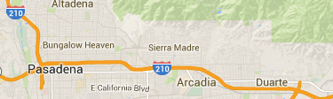
Scenario for today: No-incident
Reproduce typical day
  PM peak period
  Off-peak direction

Slide 4
Future Scenario: Incident (not today)
Reproduce incident day
Additional flow on arterial;
caused by self-diversion of drivers
Work in progress

Slide 5
Future Scenario: Incident + Intervention
Increase cycle length of arterial lights
➔ larger arterial capacity
➔ larger network-wide capacity
➔ less congestion
Work in progress

Slide 6
Calibration of the freeway model

Slide 7
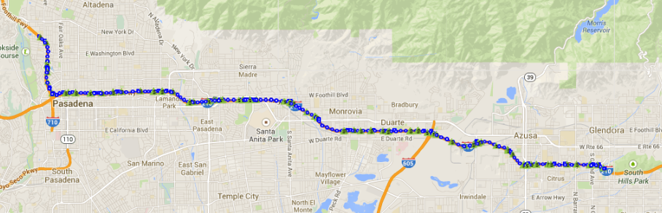
The site
19 miles of 210 Westbound from PM 42 to 23.
23 on-ramps, 21 off-ramps.
Heavy morning congestion, light afternoon congestion.
PM 23
Huntington St. detour
I-605
PM 30
PM 42

Slide 8
PeMS data
Data health on this freeway has been steadily increasing.
Our calibration focused on May 22nd, 2014.
The overall detector health on 5/22 was 81%.
There were no congestion inducing incidents on that day.
Manually identified
real
Currently being evaluated
% good detector stations
reported by PeMS
22-May-14

Slide 9
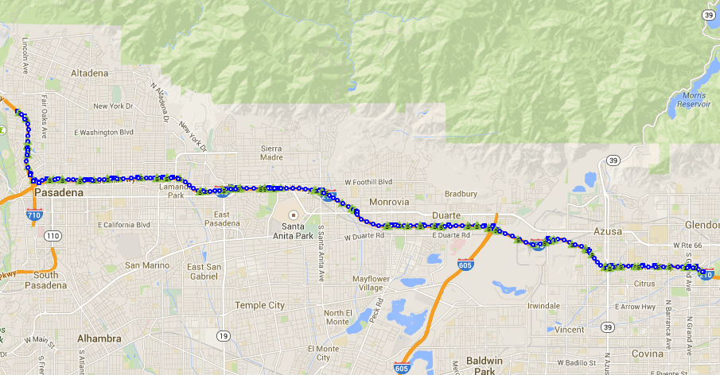
Faulty VDS (210 West, May 22nd)
#
PeMS identified bad VDS
#
Manually identified suspect VDS
717622
716592
717644
717661
717656
764146
717669
770157
716586
717634
768920
717662
717648
717663
717668
717673
761350
773206
717637
717675
717676
764346
717649
773179
772902
717652
717664
761337
773169
769702
772858
772873
717678
717686

Slide 10
Faulty VDS (210 West, May 22nd)
VDS | Type | Location | Observation (made on 5/22/2014)
717686 | ML | Grand St. | Upstream ML 717688 + OR 716614 produce higher flow.
772902 | ML | Pasadena Ave. | Speed is wrong.
717678 | ML | Azusa 1 | Upstream ML 717682 + OR 716611 produce higher flow.
717673 | ML | Mount Olive Dr. | Low freeflow speed.
769702 | ML | Highland Ave. | Location probably incorrect.
764146 | ML | Santa Anita 2 | Speed is wrong.
717669 | ML | Santa Anita 1 | Flow is wrong (too high).
773179 | ML | Vaquero Ave. | Flow is wrong (too high).
717661 | ML | Michillinda Ave. | Flow profile shape is wrong.

Slide 11
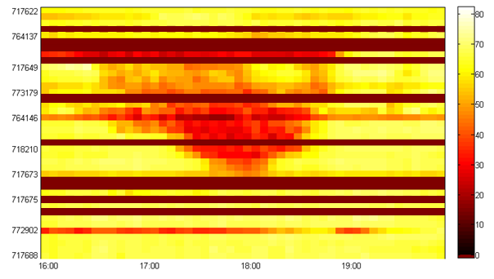
Measured congestion pattern on 5/22
Bad detection at the downstream end (beyond Sierra Madre).
Decelerations but not full congestion downstream Michillinda.
Bottleneck at Baldwin, congestion moves past Huntington to the 605.
PM 23
Sierra Madre
Michillinda
Baldwin bottleneck
Huntington
traffic flow
I-605
bad detection
PM 42

Slide 12
Freeway model construction procedure
Build the network.
Data inspection.
Calibrate the fundamental diagrams.
Impute missing ramp flows.
Run the simulation, check, make adjustments.
717668
718206
…
…
773194
E of Second
4 lanes
761342
Huntington 1
4 lanes

Slide 13
Freeway model construction procedure
Build the network.
Data inspection.
Calibrate the fundamental diagrams.
Impute missing ramp flows.
Run the simulation, check, make adjustments.
Bad detection visible in the speed contour plot.
764146
772902

Slide 14
Freeway model construction procedure
Build the network.
Data inspection.
Calibrate the fundamental diagrams.
Impute missing ramp flows.
Run the simulation, check, make adjustments.
20 days of data are fitted with a triangular fundamental diagram.

Slide 15
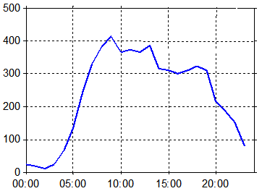
Freeway model construction procedure
Build the network.
Data inspection.
Calibrate the fundamental diagrams.
Impute missing ramp flows.
Run the simulation, check, make adjustments.
2 onramps and 11 offramps were imputed.
Baldwin SB onramp
Lake St. offramp
measured
imputed

Slide 16
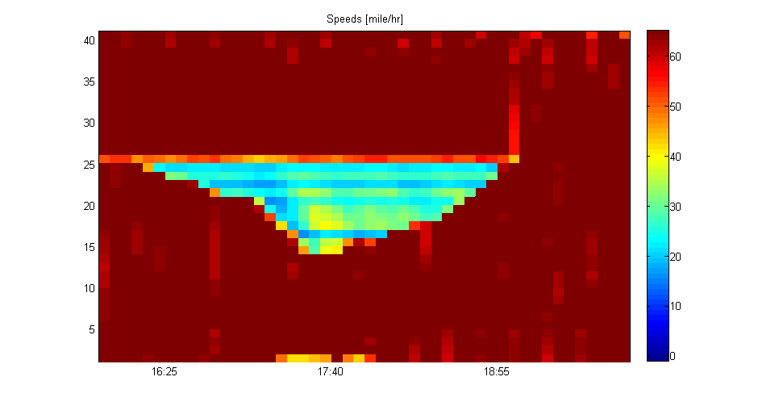
Simulation results
Inspection of congestion
16:20
18:50
Baldwin
I-605

Slide 17
Observed congestion from PeMS
Inspection of congestion
16:20
18:50
Baldwin
I-605
bad detection

Slide 18
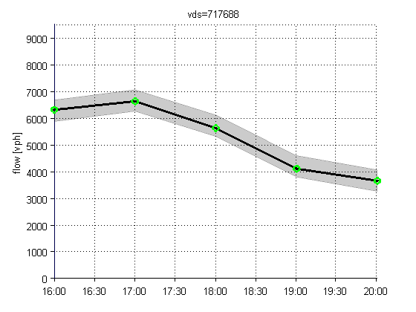
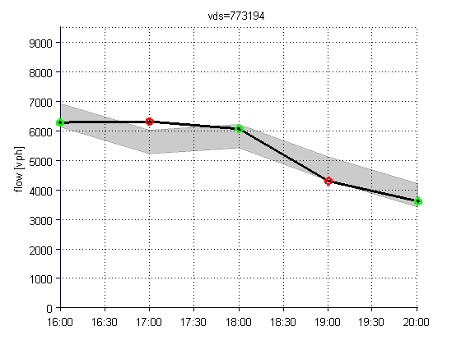
Simulation results
measured flow ±400 vph.
simulated flow within bounds.
simulated flow not within bounds.
Mainline flows
For each hour between 4pm and 8pm, check that the simulated flow is within 400 vph of the measured flow.
S Grand Ave, Azusa
East of 2nd St, Arcadia

Slide 19


FHWA calibration criteria
~80% of hourly mainline flows are within acceptable limits.
Total flows are within acceptable limits errors balance out.
Criterion | 4:00 pm 5:00 pm | 5:00 pm 6:00 pm | 6:00 pm 7:00 pm | 7:00 pm 8:00 pm
flow within 400 vph of measurement | 78% | 78% | 83% | 82%
Individual link GEH < 5 | 78% | 78% | 83% | 67%
Total flow within 5% of measurements
Total GEH < 4

Slide 20
Adding the Arterial model to the freeway model

Slide 21
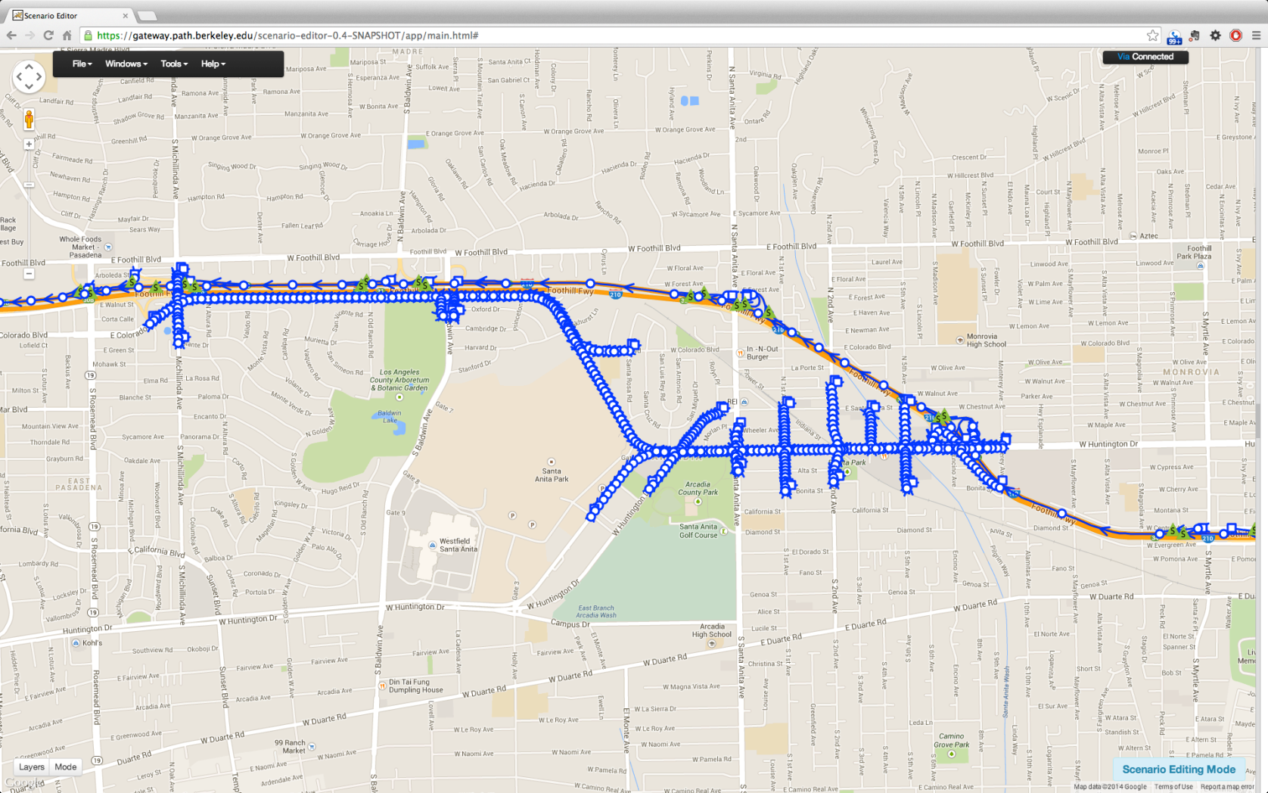
I-210 Arterial and Freeway Model
Number of links: 1001
Freeway: 210
Arterial: 791
Number of signalized intersections: 13

Slide 22
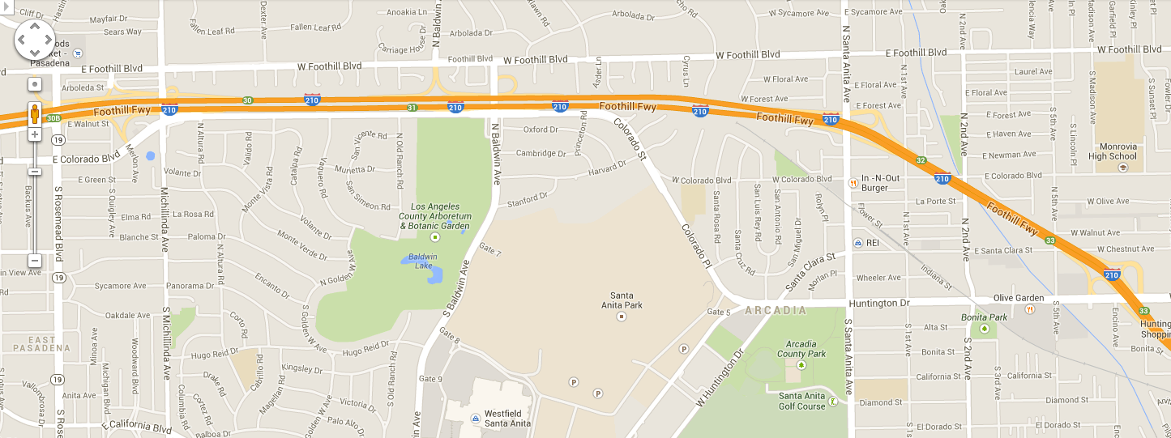
Data - Arterial
On arterial, we only have 5-min loop data at limited locations

Slide 23

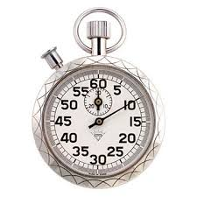
Model construction, calibration and validation
Basic information:
Network geometry
Speed limits
Signal timing
Rough turning ratios
Model Construction
Fundamental model
Model Calibration
Model with calibrated parameters
Calibration Data:
Flows
Travel times
Simulation
Density, flow, velocity
Calculation of metrics
Independent Validation Data:
Flows
Travel times
Queue length, delay, travel time
Model Validation

Slide 24
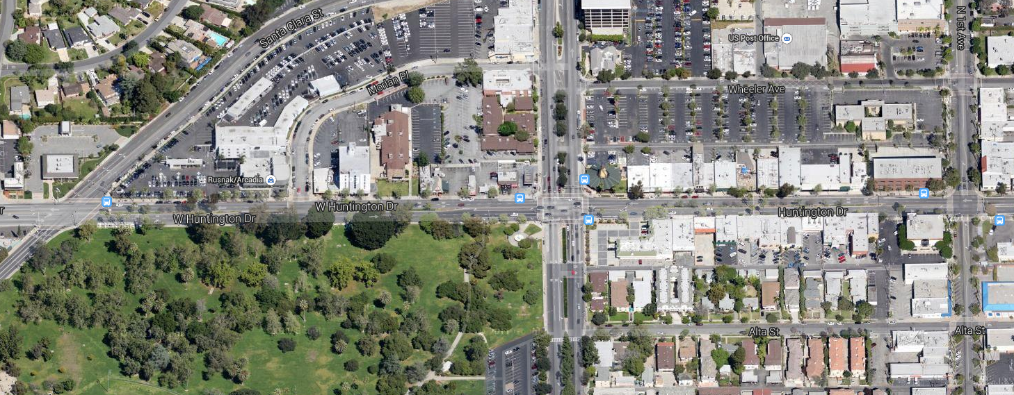
Aerial view of sensing infrastructure
Huntington & Santa Anita
~185 ft
8
4
~185 ft
6
1
2
5
~185 ft
3
7
~220 ft

Slide 25
Target Flows
Color coding:
Hourly flow from loop
(calibration dataset)
Hourly flow from racetrack,
scaled down by 35%
I210W
Hourly flow from racetrack,
scaled down by 6%
812
Default values
517
1297
Colorado Blvd
1087
210
553
Colorado Blvd
200
200
Colorado Pl
Michillinda
Baldwin / Oxford
477
Huntington
Colorado Pl
670
200
223
200
200
230
519
Colorado
322
803
1193
792
708
766
940
1065
1030
736
1035
1270
814
1016
415
100
370
200
Huntington
Santa Clara
Santa Anita
1st
2nd
Gateway
5th
I210E
I210W

Slide 26
Turning Ratios
Color coding:
Racetrack data
90%
10%
Engineering judgment
I210W
Split ratio from loop
69%
31%
24%
58%
18%
49%
44%
90%
100%
7%
10%
11%
Colorado Blvd
90%
90%
55%
45%
93%
77%
10%
10%
7%
Colorado Blvd
12%
50%
50%
50%
7%
22%
50%
Colorado Pl
71%
94%
6%
Michillinda
Baldwin / Oxford
Huntington
11%
72%
17%
8%
73%
19%
18%
82%
Colorado Pl
100%
50%
50%
74%
26%
8%
92%
100%
50%
50%
10%
5%
6%
23%
46%
2%
73%
90%
75%
10%
10%
10%
35%
Colorado
77%
54%
98%
17%
5%
19%
90%
90%
90%
65%
5%
5%
5%
3%
100%
90%
100%
10%
95%
68%
90%
60%
91%
10%
90%
27%
5%
37%
6%
Huntington
50%
50%
7%
37%
56%
17%
19%
50%
50%
64%
8%
51%
41%
Santa Clara
50%
33%
1st
2nd
Gateway
5th
I210W
Santa Anita
I210E

Slide 27
Boundary Flows
823
I210W
Baldwin / Oxford
1347
Colorado Blvd
Colorado Blvd
127
567
78
129
Colorado Pl
Michillinda
Huntington
709
89
150
518
220
Colorado Pl
332
173
228
Colorado
1028
200
Huntington
1059
487
364
166
Santa Clara
Santa Anita
1st
2nd
Gateway
5th
I210E
I210W

Slide 28
Westbound traffic on Huntington and Colorado

Slide 29
Eastbound traffic on Huntington and Colorado

Slide 30
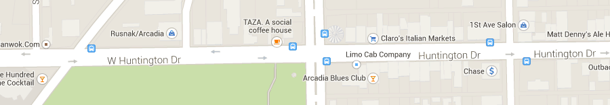
Estimated Travel Time

Slide 31
Estimated vs. Measured Flows, 16:00-17:00
Individual link flows | Passed cases | Targets
Flow within 100 vph for link flows < 700 vph | 4/5 = 80% | > 85%
Flow within 15% for 700 vph < link flows < 2700 vph | 6/9 = 67% | > 85%
Flow within 400 vph for link flows > 2700 vph | 0/0 | > 85%
GEH statistics < 5 | 10/14 = 71% | > 85%
Sum of all link flows | Results | Targets
Relative Error in Total Flow | 5.4% | < 5%
GEH | 5.5 | < 4

Slide 32
Estimated vs. Measured Flows, 17:00-18:00
Individual link flows | Passed cases | Targets
Flow within 100 vph for link flows < 700 vph | 4/5 = 80% | > 85%
Flow within 15% for 700 vph < link flows < 2700 vph | 6/9 = 67% | > 85%
Flow within 400 vph for link flows > 2700 vph | 0/0 | > 85%
GEH statistics < 5 | 10/14 = 71% | > 85%
Sum of all link flows | Results | Targets
Relative Error in Total Flow | 2.5% | < 5%
GEH | 2.6 | < 4

Slide 33
Estimated vs. Measured Flows, 18:00-19:00
Individual link flows | Passed cases | Targets
Flow within 100 vph for link flows < 700 vph | 10/10 = 100% | > 85%
Flow within 15% for 700 vph < link flows < 2700 vph | 3/4 = 75% | > 85%
Flow within 400 vph for link flows > 2700 vph | 0/0 | > 85%
GEH statistics < 5 | 13/14 = 93% | > 85%
Sum of all link flows | Results | Targets
Relative Error in Total Flow | 5.0% | < 5%
GEH | 4.7 | < 4

Slide 34
Estimated vs. Measured Flows, 19:00-20:00
Individual link flows | Passed cases | Targets
Flow within 100 vph for link flows < 700 vph | 8/12 = 67% | > 85%
Flow within 15% for 700 vph < link flows < 2700 vph | 2/2 = 100% | > 85%
Flow within 400 vph for link flows > 2700 vph | 0/0 | > 85%
GEH statistics < 5 | 10/14 = 71% | > 85%
Sum of all link flows | Results | Targets
Relative Error in Total Flow | 22.4% | < 5%
GEH | 16.7 | < 4

Slide 35
Estimated vs measured travel times
[ Validation of CTM Forward Simulation of Arterial Loop+Racetrack No-Incident Model ]
16:00-17:00
Journey time within network | Passed cases | Targets
Within 15% or 1 minute, whichever criteria is higher | 1/1 = 100% | > 85%
17:00-18:00
Journey time within network | Passed cases | Targets
Within 15% or 1 minute, whichever criteria is higher | 1/1 = 100% | > 85%

Slide 36
Supplemental Slides

Slide 37
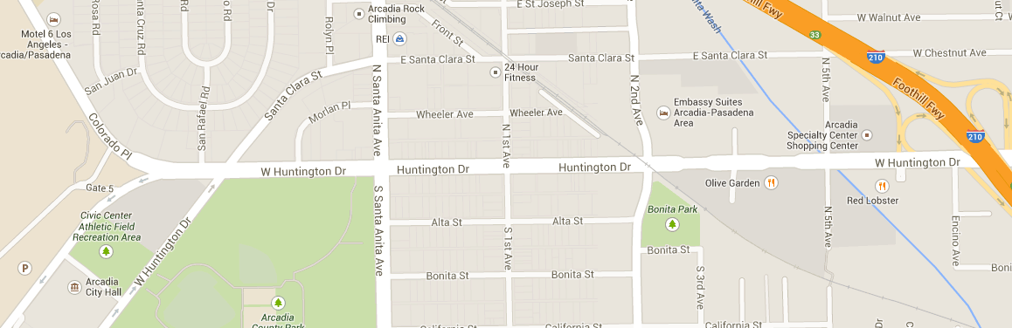
Estimated vs. Measured Flows
[ Validation of CTM Forward Simulation of Arterial Loop+Racetrack No-Incident Model ]
Based on calibration dataset
Based on validation dataset
Huntington

