Slide 1









Connected Corridors
I-210 Corridor Analysis, Modeling & Simulation
Date: August 13, 2014
Caltrans District 7
July 16, 2014

Slide 2
Introduction to AMS on the I-210 Corridor
Why AMS
  Enhance common understanding among stakeholders
  Test the applicability of various control strategies based on ramp meters, signal lights, and the managed routing of travelers (roads, transit, etc.)
  Provide justification for repairing and upgrading both sensing infrastructure and control elements
Outputs
  AMS Final Report: Evaluation of ICM benefits and costs
  Generation of strategies and response plans for use in the Concept of Operations
  Better understanding of System Engineering Requirements

Slide 3
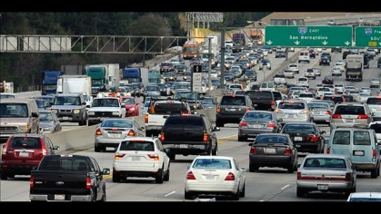


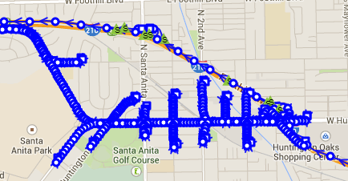
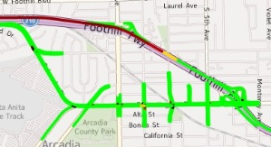

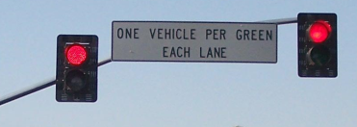

AMS on the I-210 Corridor
Assess Operations
Select Scenarios
Create Models
Simulate
Evaluate
Select Interventions
Assess Costs

Slide 4
Outline for AMS Final Report
Introduction and background
Corridor description
AMS methodology
  Modelling approach
  Simulation model
  Data requirements
Analysis scenarios and ICM strategies
Model calibration approach and methodology
  Calibration acceptance criteria
  Validation
Performance measures
  Mobility and other metrics
  Framework for costs/benefits analysis
ICM deployment analysis findings
  Overall ICM performance
  ICM benefits
  ICM costs
  Benefit cost analysis
Conclusions and lessons learned
Recommendations
Executive summary

Slide 5




AMS Network
Freeway network extends
past Azusa toward the east
Fair Oaks Ave
Marengo Ave
Lake Ave
Allen Ave
Altadena Ave
Colorado Blvd
Los Robles
Hill Ave
Sierra Madre Villa Ave
San Gabriel Blvd
Michililinda Ave
Colorado St
Colorado Pl
Maple St
Orange Grove Blvd
Myrtle Ave
Mountain Ave
Corson St
Foothill Blvd
Buena Vista St
Walnut St
Huntington Dr
Duarte Rd
Santa Anita Ave
Four arterials in Pasadena:
Maple and Corson access roads plus
Orange Grove and Walnut
Azusa Ave
Two arterials in Arcadia and Eastward:
(1) Foothill and Duarte via Santa Anita
(2) Colorado and Huntington

Slide 6
Assessment of Corridor Operations
Assess Operations
Description of corridor facilities over a larger area
Understanding key transportation challenges
Inventory of field elements
Select Scenarios
Create Models
Simulate
Evaluate
Select Interventions
Assess Costs

Slide 7



AADT and Truck Volumes - Freeway
297,000
261,000
266,000
244,000
190,000
136,000
6,952
(5.11%)
9.249
(3.11%)
13,534
(5.19%)
12,873
(4.84%)
11,688
(4.80%)
4,390
(2.31%)
PM 24.96
PM 26.32
PM 29.63
PM 32.89
PM 36.41
PM 37.86
PM 39.60
PM 41.59
PM 44.38
Lake
Avenue
Rosemead
Boulevard
Huntington
Drive
Irwindale
Avenue
Azusa
Avenue
Grand
Avenue
AADT – All Vehicles
AADT – Heavy-Duty Trucks

Slide 8
Average Freeway Travel Times (Sept 2013)

Slide 9
Congested Areas
AM Peak
Frequently congested areas
PM Peak

Slide 10
Major Bottlenecks – AM Peak
Heavy traffic from Lake on-ramp (~900 vph)
Heavy entering traffic from consecutive San Gabriel and Altadena on-ramps
(~1400 vph)
Heavy entering traffic from consecutive Michillanda, Foothill and Rosemead on-ramps (~1700 vph)
Heavy entering traffic from two consecutive Baldwin on-ramps
Heavy traffic from two consecutive on-ramps
(~1000 vph)
Weaving traffic seeking to take the I-210 NB Connector
Heavy traffic from two consecutive Santa Anita on-ramps (~1000 vph)
Weaving from mainline traffic trying to get to the outer lanes to take the I-605 exit
Heavy traffic from two consecutive on-ramps
(~1000 vph)
Traffic weaving to take Sierra Madre exit
Traffic merging at the crest of a large horizontal curve
Traffic merging at crest of a curve
Traffic merging at the crest of a large horizontal curve
Sierra Madre
Los Robles
San Gabriel
Santa Anita
Fair Oaks
Altadena
Baldwin
Lake
Allen
Hill
Mountain
Myrtl
Buena Vista
Lone Hill
Irwindale
Azusa
Citrus
Grand
Amelia
San Dimas Ave
San Dimas Canyon
Merging traffic from SR-134 and I-210 SB
Traffic entering from consecutive Santa Anita and Huntington on-ramps (~950 vph)
Entering traffic from Mountain and Buena Vista consecutive on-ramps (>600 vph)
Significant on-ramp traffic (~600 vph)
Heavy on-ramp traffic
Traffic merging at the crest of a large horizontal curve
Traffic weaving to the outer lanes to take I-605 SB exit
Eastbound Bottleneck
Westbound Bottleneck
Frequently Congested Segment
Data source: 2010 Corridor CSMP

Slide 11
Major Bottlenecks – PM Peak
Heavy traffic from Lake on-ramp (~1000 vph)
Heavy entering traffic from consecutive San Gabriel and Altadena on-ramps
(~1200 vph)
Heavy entering traffic from consecutive Michillanda, Foothill and Rosemead on-ramps (~1700 vph)
Heavy entering traffic from two consecutive Baldwin on-ramps
Heavy traffic from two consecutive on-ramps
(~1200 vph)
Weaving from mainline traffic trying to get to the outer lanes to take the I-605 exit
Heavy traffic from two consecutive on-ramps
(~600 vph)
Weaving from traffic seeking to take the I-210 NB connector
Weaving from traffic exiting at Sierra Madre
Heavy traffic from two consecutive Santa Anita on-ramps (~700 vph)
Traffic merging at the crest of a large horizontal curve
Sierra Madre
Traffic merging at crest of a curve
Traffic merging at the crest of a large horizontal curve
Los Robles
San Gabriel
Santa Anita
Fair Oaks
Altadena
Baldwin
Lake
Allen
Hill
Mountain
Myrtl
Buena Vista
Lone Hill
Irwindale
Azusa
Citrus
Grand
Amelia
San Dimas Ave
San Dimas Canyon
Merging traffic from SR-134 and I-210 SB
Entering traffic from San Gabriel on-ramp (~550 vph)
Traffic entering from consecutive Rosemead and Michilinda on-ramps with mainline traffic near capacity (~400 vph)
Traffic entering from consecutive Santa Anita and Huntington on-ramps (~1200 vph)
Heavy entering traffic from Mountain and Buena Vista consecutive on-ramps (~1200 vph)
Demand from on-ramps exceeding available mainline capacity
Heavy traffic from Lake on-ramp (~800 vph)
Large horizontal curves between San Gabriel and Sierra Madre
Traffic merging at the crest of a large horizontal curve
Traffic weaving to take to I-605 SB exit
Eastbound Bottleneck
Westbound Bottleneck
Frequently Congested Segment
Data source: 2010 Corridor CSMP

Slide 12
AM Collisions involving CHP, by Type (2010-2011)

Slide 13
AM Collisions involving CHP, by Type (2010-2011)

Slide 14
PM Collisions involving CHP, by Type (2010-2011)

Slide 15





Freeway – HOV/HOT Lanes
Restriction in place 24/7
Converted to HOT Facility February 2013
Freeway
Existing HOV Lane
Entry/Exit Point
Arterial
Existing HOT Lane
Entry Only
Interchange
HOV Lane Under Construction
Exit Only
HOV Lane in Design Stage
HOV Lane in Planning Stage

Slide 16
Freeway Ramp Metering Capability
Currently operating: SATMS - Local Responsive using 170 Controller
2009
SWARM
Test Area
To
Lake Ave
2001 SWARM
Test Area
Baseline Ave
Vernon Ave
HOV Lane
EB
HOV Lane
WB - From SB Foothill
HOV Lane
Mt Olive Ramps
HOV Lanes EB/WB
HOV Bypass SB
HOV Lane
EB - From SB Citrus
HOV Lane
EB - From SB Azusa
HOV Lane
WB - From SB Grand
HOV Lane EB
HOV Bypass NB/SB
HOV Bypass SB
HOV Bypass NB/SB
HOV Bypass NB
HOV Bypass EB
HOV Bypass
3 of 4 Ramps
HOV Bypass
WB
HOV Bypass EB/WB
HOV Bypass EB/WB
HOV Bypass
WB
HOV Bypass WB
HOV Bypass
WB 1 of 2 Ramps
HOV Bypass
WB/EB
HOV Bypass WB
HOV Bypass
WB 1 of 2 Ramps
Metered Ramp/Connector
Partially Metered Ramp/Connector
Unmetered Ramp/Connector

Slide 17
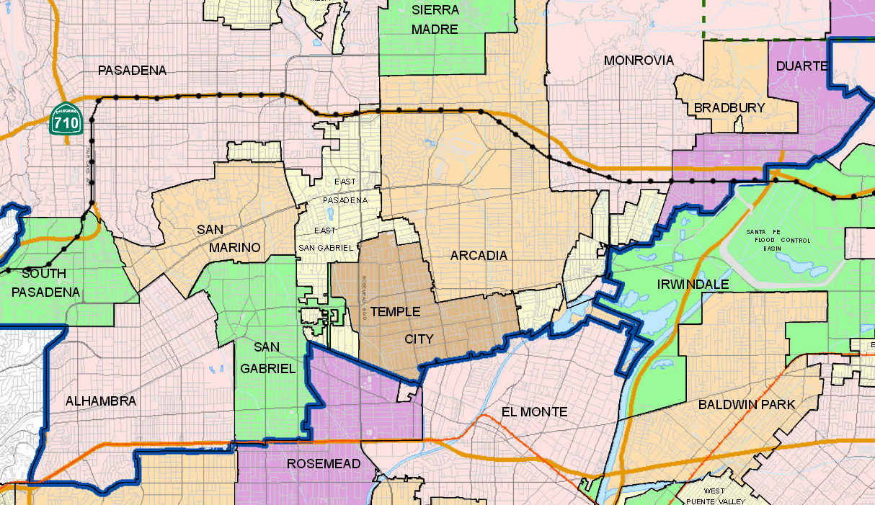
Traffic Signals – TCS Host
S
S
S
S
S
S
S
S
S
S
S
S
S
S
S
S
S
S
S
S
S
S
S
S
S
S
S
S
S
S
S
S
S
S
Inventory as of June 2014
McCain - QuickNet Pro
Siemens - i2tms
SCATS
Transcore - Series 2000
Transcore - TransSuite
Transcore - TransSuite (Planned)
KITS
KITS (Planned)
Not determined
S
Stop Controlled

Slide 18
Detection – Arterial Sensor Types
S
S
S
S
S
S
S
S
S
S
S
S
S
S
S
S
S
S
S
S
S
S
S
S
S
S
S
S
S
Video Detection
Inductive Loops
Video & Inductive Loops
No Detection/ Unknown
None (Stop Sign)

Slide 19
Detection – Approach Volume Availability
S
S
S
S
S
S
S
S
S
S
S
S
S
S
S
S
S
S
S
S
S
S
S
S
S
S
S
S
S
S
S
S
S
S
S
Coverage
All approches
Some approches
No approach / Not determined
Pasadena – McCain QuickNet Pro
Pasadena – Siemens i2tms
Pasadena – SCATS
Collection System
Pasadena – Transcore Series 2000
Arcadia – Transcore TransSuite
Monrovia – No central system
Duarte – No central system
LA County – KITS
Caltrans – No central system
S
Stop Controlled Intersection

Slide 20
Park & Ride – Facilities
P 50
P 877
88
R
Sierra Madre Villa
Lake
Allen
R
P 300
P 200
Arcadia
P 338
P 125
P 326
P 200
Monrovia
Citrus
Duarte
Irwindale
Alameda
P 750
P 610
Memorial Park
P 102
P 55
$
P 130
30
Del Mar
P 50
P 200
P 500
R
Fillmore
P 231
P 40
P 190
P 300
P 655
Mission
$
Baldwin Park
P 226 .
P 100
El Monte
Metrolink
R
P 2155
P 94
Covina
P 88
Cal State Los Angeles
P 128
P 238
P 420
P 10
P 239
P 500
$
P 128
El Monte Bus Station
P 70
West Covina
P 366
P 100
Metro Silver Line
P 100
Existing LA Metro Lots
$
Parking Fee
Metro Gold Line
P 100
Future LA Metro Lots (late 2015)
Paid Reserved Parking
Gold Line Extension Phase 2A
P 100
Metrolink Lots
R
Gold Line Extension Phase 2B
P 100
Caltrans Lots
Metrolink San Bernardino
P 100
Los Angeles County Lots
Express Bus Lines
P 100
Other Park-and-Ride Lots

Slide 21
Light-Rail, Transitway and Commuter Rail
Late 2015 Planned Opening
Allen
Lake
Sierra Madre Villa
Arcadia
Citrus
Monrovia
Duarte
Alameda
Irwindale
Memorial Park
Del Mar
Fillmore
San Dimas (Planned)
Mission
Baldwin Park
Covina
El Monte Metrolink
Cal State Los Angeles
El Monte Bus Station
West Covina
LA Metro Silver Line
Transit Station
LA Metro Gold Line
Gold Line Foothill Extension Phase 2A
Metrolink San Bernardino
Gold Line Foothil Extension Phase 2B

Slide 22
Select Representative Operational Scenarios
Assess Operations
Engage stakeholders
Identify problem types we want to fix
Identify scenarios that are representative of corridor operations
Select Scenarios
Create Models
Simulate
Evaluate
Select Interventions
Assess Costs

Slide 23
I-210 Pilot Project Goals and Objectives
Initial focus is on managing incidents/events, with gradual expansion to demand management and commute congestion
Develop a pilot system that can be replicated on other corridors and be a model for other corridors in the state and country
Initial System
Incident/Event
Management
Incident/Event
Management
Incident/Event
Management
Transit/parking Management
Time
Transit/parking Management
Transit Management
Commute Traffic Management

Slide 24
AMS Scenarios
Demand Class | ICM Intervention | No incident | Freeway incident | Arterial incident
High | no
 | yes
Medium | no
 | yes

Slide 25
Summary of Analysis Settings
Parameter | Comment
Analysis year | 2014 chosen on having available data on the I-210 freeway and some arterials
Time period of analysis | PM peak
Simulation period | 3 PM - 8 PM is the primary analysis period.
Freeway incident location | Chosen to represent an historically accurate and major blockage during the peak period
Freeway incident severity | Major – at least one lane closed
Arterial incident location | Chosen to represent an historically accurate and major blockage during the peak period
Arterial incident severity | Major – at least one lane closed
Incident duration | Chosen to represent an historically accurate and major blockage, for example 30-90 minutes

Slide 26
Select ICM Intervention Strategies
Assess Operations
Engage stakeholders
Identify ICM strategies most appropriate for the challenges at hand
Target infrastructure investments that are realistic
Select Scenarios
Create Models
Simulate
Evaluate
Select Interventions
Assess Costs

Slide 27
ICM Strategies
Coordinated freeway-arterial operations
  Coordinated ramp metering and signal synchronization
  Use of arterial capacity to supplement freeway operations
  Use of freeway capacity to supplement arterial operations
Active re-routing around major incidents
  Provide way-finding and actionable travel information in addition to coordinated ramp metering and signal synchronization

Slide 28

Coordinated arterial-freeway operations
Coordinated ramp metering and signal synchronization
  Provide extra arterial capacity to support increased demand
  Facilitate re-entry onto freeway downstream of incident bottleneck

Slide 29
Coordinated arterial-freeway operations
Coordinated ramp metering and signal synchronization
  Adjust arterial signals to favor movements around incident location
  Facilitate entry onto freeway upstream of arterial incident location

Slide 30
Active re-routing around major incidents
Provide way-finding and actionable travel information in addition to coordinated ramp metering and signal synchronization
Accident ahead

Slide 31
Model Building
Assess Operations
Select Scenarios
Create Models
Simulate
Evaluate
Select Interventions
Assess Costs

Slide 32



Model Building Process
Incomplete information from different years
Basic information for model construction
No-incident
Data pre-processing
Sanity
Consistency
Engineering judgement
Model construction calibration and validation
Incident
Calibration data
Incident + intervention
Validation data

Slide 33
Model construction, calibration and validation
Basic information:
Network geometry
Speed limits
Signal timing
Rough turning ratios
Model Construction
Basic model
Model Calibration
Model with calibrated parameters
Calibration Data:
Flows
Travel times
Simulation
Density, flow, velocity
Calculation of metrics
Independent Validation Data:
Flows
Travel times
Queue length, delay, travel time
Model Validation

Slide 34
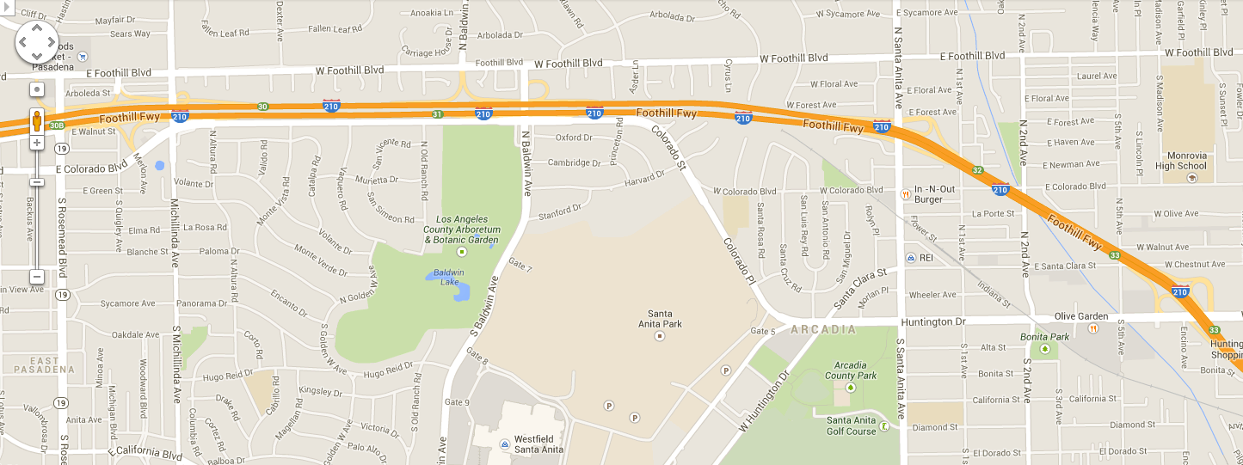
Example of arterial data
Coverage of 5-min loop data

Slide 35
Calibration Guidelines
Calibration Criteria and Measures | Calibration Acceptance Targets
Traffic flows within 15% of observed volumes for links with peak-period volumes greater than 2,000 vph | For 85% of cases for links with peak-period volumes greater than 2,000 vph
 | Separate thresholds for arterials and freeways?
Sum of all link flows | Within 5% of sum of all link counts
Travel times within 15% | For 85% of cases
Recurrent bottleneck congestion | Spatial-temporal match within 30 minutes and 1/2 mile of observed congestion
Incident-related congestion | Duration within 25% of observation
 | Queue propagation within 20% of observation

Slide 36
Simulate and Assess Performance
Assess Operations
Select Scenarios
Create Models
Simulate
Evaluate
Select Interventions
Assess Costs

Slide 37


Simulation and Performance Assessment
No-incident
Simulation Engine
Flow
Speed
Density
Performance Measures
Incident
Incident + intervention

Slide 38
Corridor Performance Measures
Travel Time
  during specified time period
  freeway mainline
  freeway → arterial → freeway
Buffer index for travel time reliability
Flow
Speed
Density
Emission
  rate (per vehicle)
  total
Total Delay
Vehicle Hours Traveled
Vehicle Miles Traveled
Person Hours Traveled
Person Miles Traveled
    during specified time period
  by jurisdiction
  by facility
Fuel Consumption
  rate (per vehicle)
  total
Collision / Fatality
  rate (per million VMT)
  total

Slide 39
Assess Costs and Evaluate Benefits
Assess Operations
Select Scenarios
Create Models
Simulate
Evaluate
Select Interventions
Assess Costs

Slide 40
Evaluation of benefits and ICM investments
Infrastructure | Capabilities | Benefits
Existing infrastructure | Ramp metering | Limited benefits
 | Signal synchronization
Enhanced infrastructure | Improved ramp metering | Greater benefits
 | Wider-area signal synchronization
 | Coordination of ramps and signals
 | Active reroutes
Calculate costs of enhancements | Evaluate | Calculate benefits of enhancements

